Slide 1
A novel approach to analyzing the caliber of University of Washington Medicine clinical ethics consults
Alison King and Katie McFarlane
In collaboration with the UW Department of Bioethics

Slide 2


Meet the Team
Katie McFarlane
Alison King
UW Bioethics Department
Dr. Jim Kirkpatrick
Niambi Kanye
Mandy Morneault

Slide 3
Background
Most hospitals offer ethics consults, no universal quality standard for these consultations exists
Regulation of ethics consultations
Greater completion rates and overall quality of consults
Conjecture
First step: create a framework to analyze the completion and quality
Notes:
Ethics consults: consultations between ethics consultants and a client (patient, doctor, family of patient, etc.) regarding some ethical issue (e.g. end of life care) in hopes of addressing this issue

Slide 4
Consult Data
Field​ | Example​
Consult Location​ | UWMC - Montlake​
Lead Consultant ID​ | C1​
Assistant Consultant(s)​ | N/A​
Caller's Role / Service​ | Resident / Orthopedic​
Total Time Spent (minutes) | 300
Primary Ethics Issue​ | End of Life Care Issue​
Additional Issue(s)​ | Guardianship​
Patient had Decision Making Capacity​ | No​
Legal Surrogate Contacted​ | Yes​
326 formal UW Medicine clinical ethics consults from 1/1/2017, to 6/21/2022
UW Medical Centers Montlake, Northwest, and Harborview
12 consultants

Slide 5
Objectives and Outcomes
Rank completeness and quality, accounting for varying caseloads and difficulties of ethical issues
Primary Goal
Secondary Goal
Rank consultants’ overall completion of consults
Rank consultants’ overall quality of consults
Binary completion variable
Continuous quality score

Slide 6
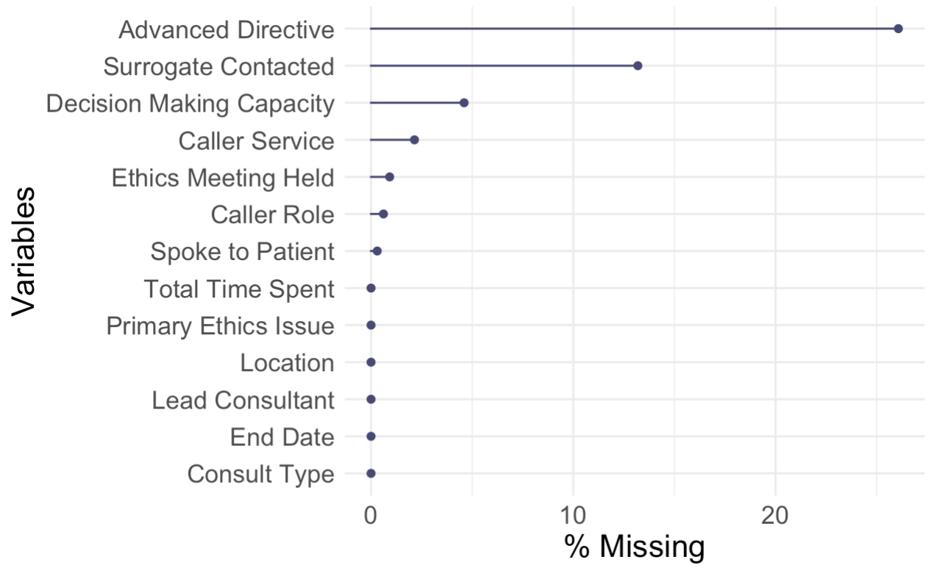
Completion Outcome
Are all key fields of the consultation documentation filled out?

Slide 7
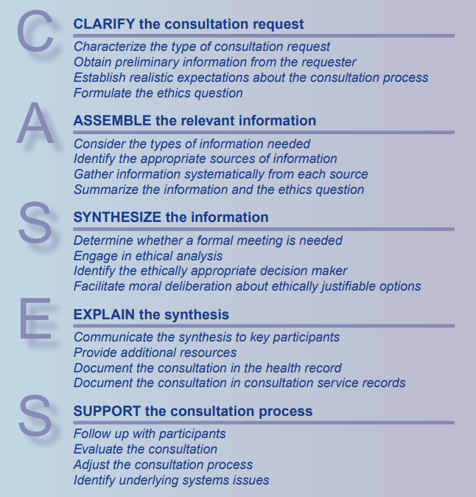
Quality Score: CASES Standard
U.S. Department of Veterans Affairs National Center for Ethics Care IntegratedEthics® Service: "CASES" approach (pictured right)

Slide 8
Quality Score: CASES
One or two variables mapped to each aspect of CASES
Clarify
Caller role and caller service
Spoke to patient or surrogate
Determined primary ethics issue
Wrote explanation of ethical obligations
Amount of time and how time was spent
Assemble
Synthesize
Explain
Support

Slide 9
The Provider Ranking Model
Specify mixed effects logistic regression model
Random intercepts for lead consultant
Case-mix adjustment (fixed effects) for primary ethics issue consolidated into top 5 issues
Predict adjusted completion rates
Model prevents small caseloads and differences in difficulty from misclassifying consultants' completion
Repeat for secondary model using linear regression

Slide 10
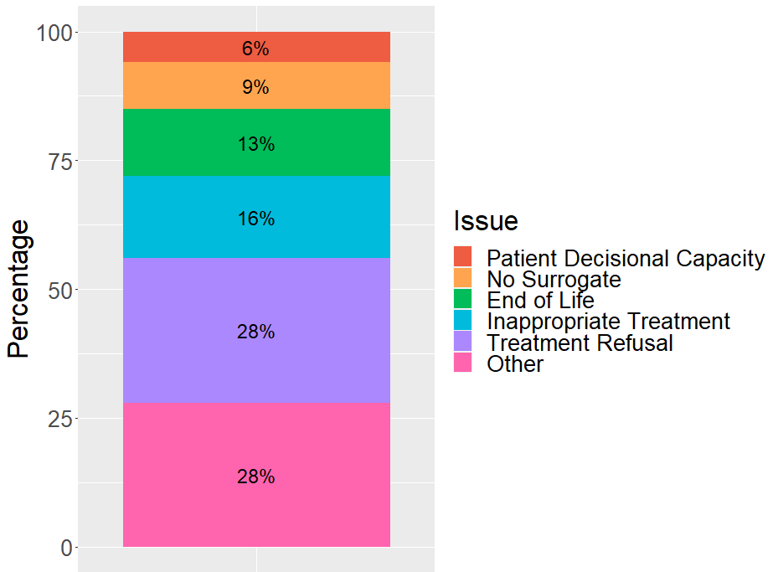
Descriptive Statistics: Primary Ethics Issues
Issues compiled into top 5 issues and “Other”
Other consists of 15 less common issues and those labeled as “Other” by consultants
These 6 categories are used in the models for adjustment

Slide 11
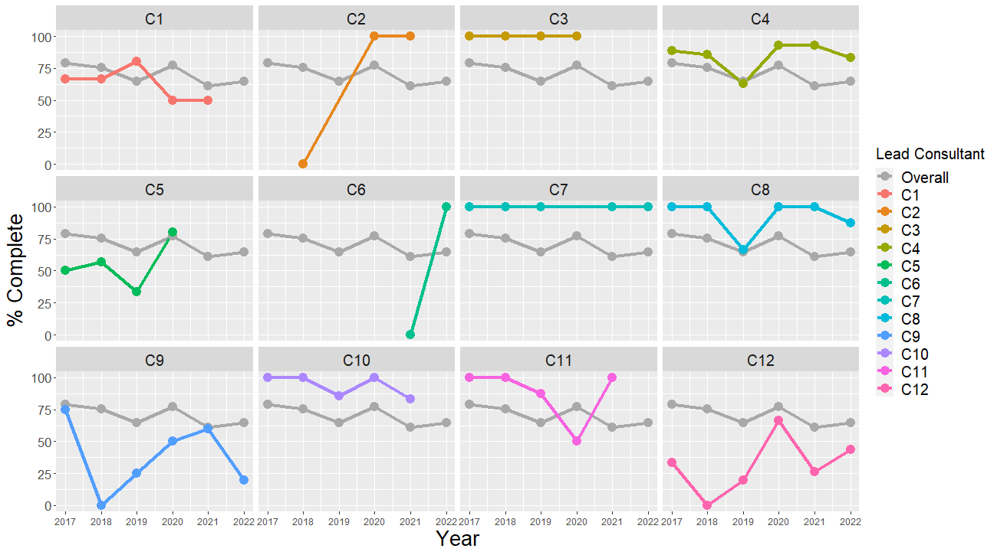
Descriptive Statistics: Completion

Slide 12
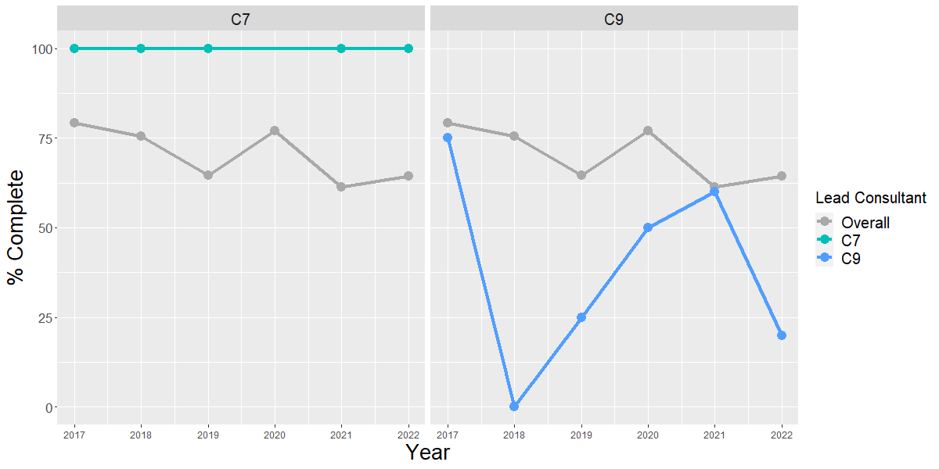
Descriptive Statistics: Completion

Slide 13
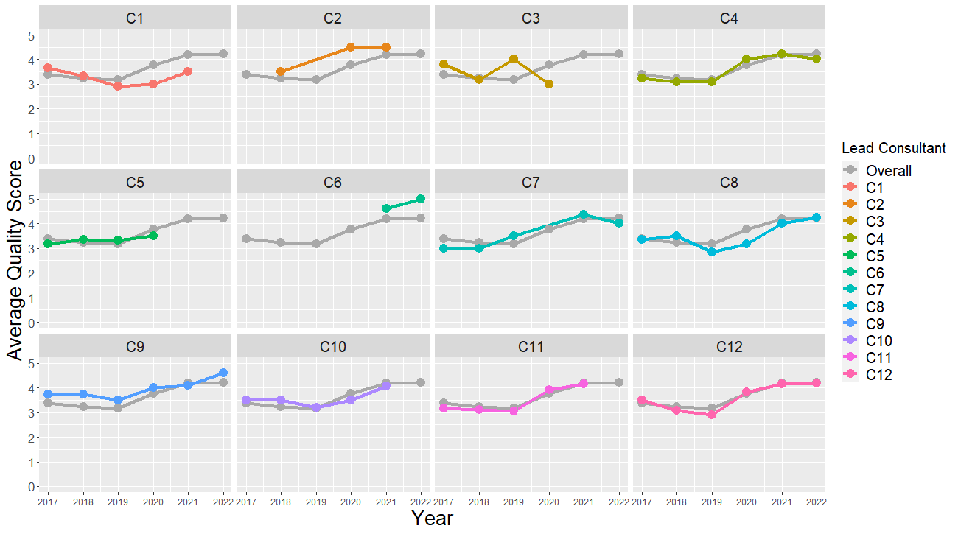
Descriptive Statistics: Quality

Slide 14
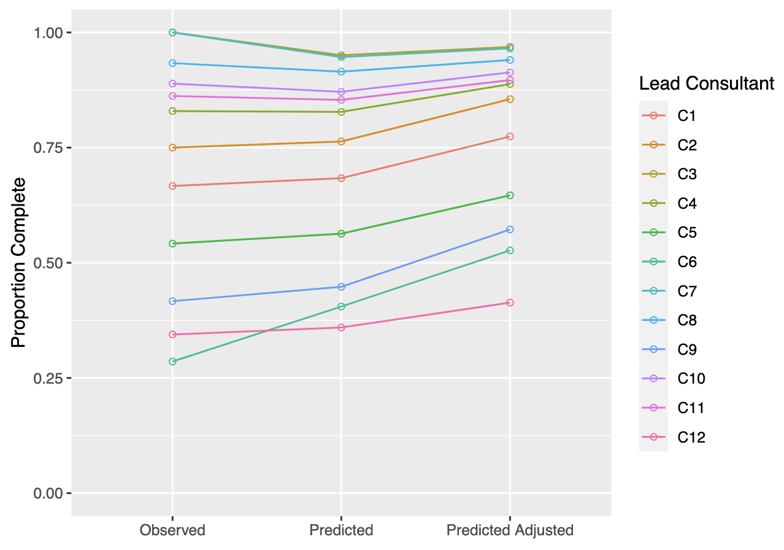
Primary Results
Predicted proportions shrink towards the center as this method accounts for different numbers of consults
Adjustment for primary ethical issue did not change ranking results

Slide 15
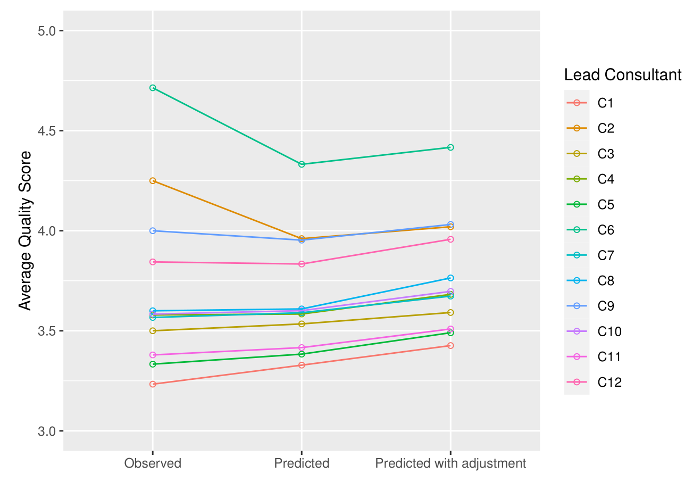
Secondary Results
Consultants’ scores do not have a large range
As with primary results, we see a shrinkage effect, and adjustment for primary ethics issues had little effect on results

Slide 16
Discussion
Summary
We were able to rank consultants on completeness and quality
Impacts
A novel method for quantitatively assessing clinical ethics consultations
First step in evaluating quality and completeness of ethics consultations
Limitations
Small number of consultants
Consultant self-reporting and subjectivity
May not generalize to other hospitals with different data collection systems

Slide 17
Next Steps
Apply these provider ranking methods to more institutions with clinical ethics consultations
Research other covariates within consultation documentation associated with completion and quality
Perform a mixed-methods analysis of quality combining the clinical ethics standards from the VA IntegratedEthics® Service CASES and the American Society for Bioethics & Humanities Core Competencies

Slide 18
Thank you!
Questions?

Slide 19
References
Berkowitz K, Chanko B, Foglia M, Fox E, Powell T. National Center for Ethics in Health Care, Ethics Consultation: Responding to Ethics Questions in Health Care. 2nd ed. Washington, DC: U.S. Department of Veterans Affairs; 2015.
Ethics Consultation, UW Department of Bioethics & Humanities. depts.washington.edu. Accessed October 2022. https://depts.washington.edu/bhdept/ethics-medicine/ethics-consultation
Fiester A. Neglected Ends: Clinical Ethics Consultation and the Prospects for Closure. The American Journal of Bioethics. 2015;15(1):29-36. doi:10.1080/15265161.2014.974770
Gaudine A, Lamb M, LeFort SM, Thorne L. Barriers and facilitators to consulting hospital clinical ethics committees. Nursing Ethics. 2011;18(6):767-780. doi:10.1177/0969733011403808
Geppert CMA, Shelton WN. A Comparison of General Medical and Clinical Ethics Consultations: What Can We Learn From Each Other? Mayo Clinic Proceedings. 2012;87(4):381-389. doi:10.1016/j.mayocp.2011.10.010
Pearlman, RA. Ethics Committees and Consultation, Department of Bioethics & Humanities. depts.washington.edu. Accessed October 2022. https://depts.washington.edu/bhdept/ethics-medicine/bioethics-topics/detail/64.
Resources for Developing Advanced Skills in Ethics Consultation. Chicago, IL: American Society for Bioethics and Humanities; 2017. https://asbh.org/uploads/publications/Resources_for_Ethics_Consultation.pdf.
Scher DS, Kozlowska DK. Rethinking Health Care Ethics. Chapter 3: The Rise of Bioethics: A Historical Overview. Singapore: Palgrave Pivot; 2018. https://www.ncbi.nlm.nih.gov/books/NBK543570/

Slide 20
Appendix A: Sensitivity Analysis Methods
To see how robust our findings are when including other, less-understood variables in our models
Simplest Most Complex
Simple model with random intercepts for consultants
Our model
Multivariate model with addition of number of secondary consultants/
issues and time to completion

Slide 21
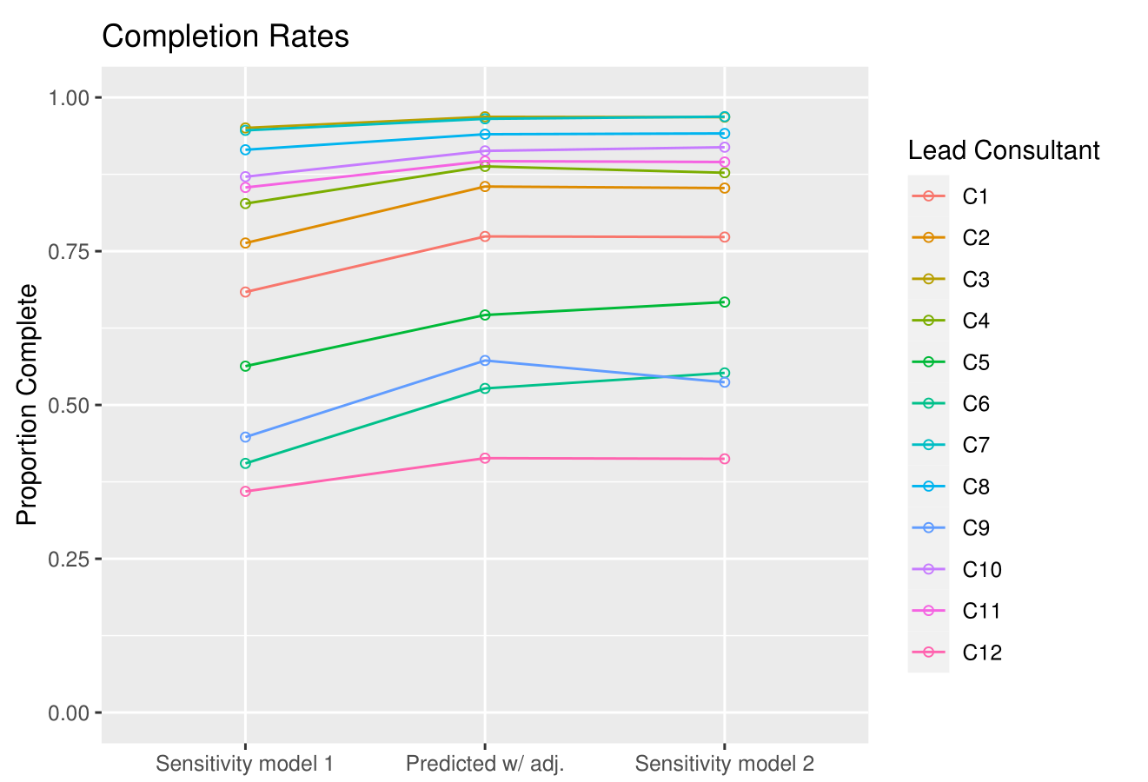
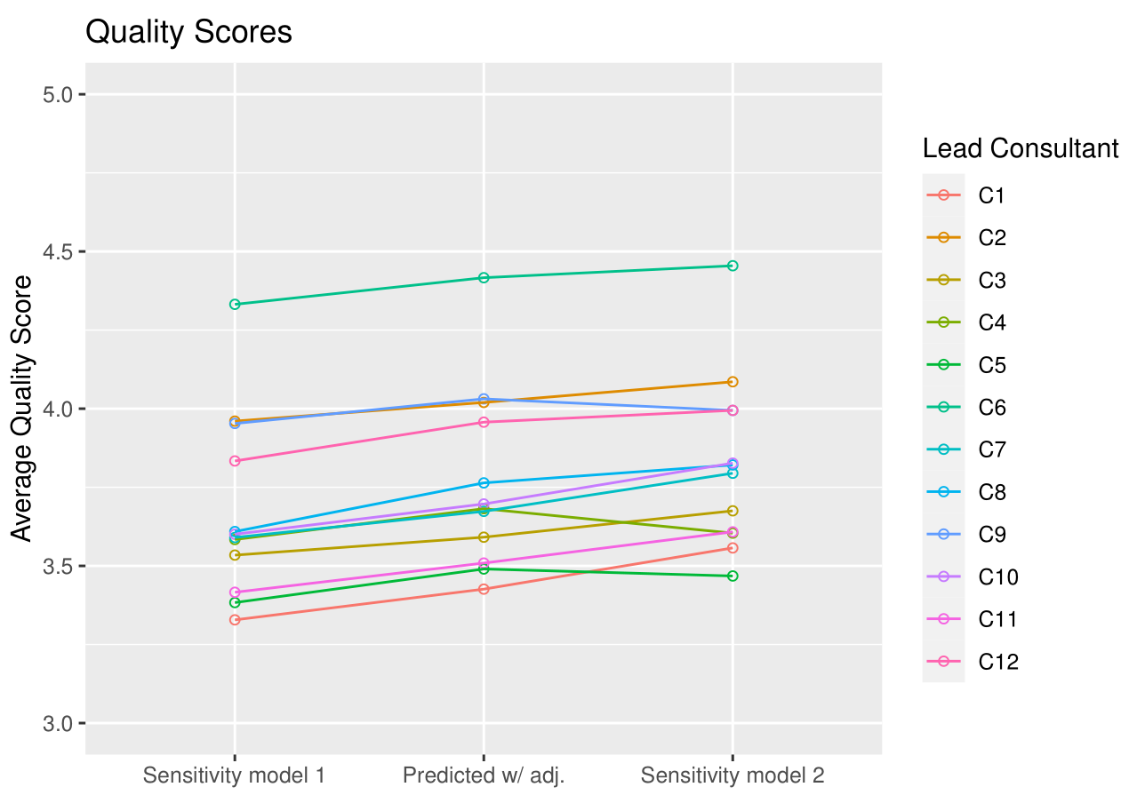
Appendix B: Sensitivity Analysis Results

Slide 22
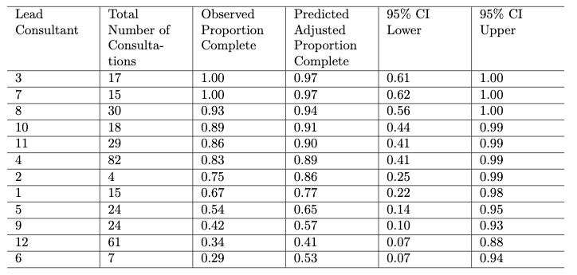
Appendix C: Primary Model Prediction Intervals

Slide 23
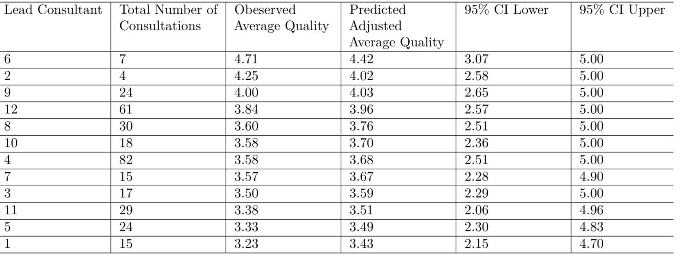
Appendix D: Secondary Model Prediction Intervals

